Slide 1
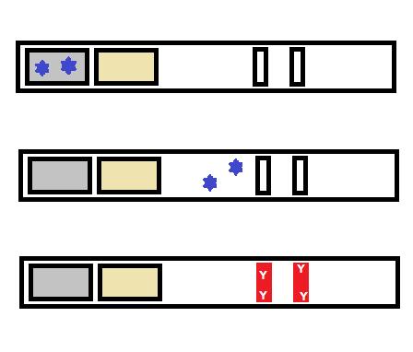
Sample Pad
Conjugate Pad
Test Line
Control Line
Y
Y
Y
Y
Y
Y
Y
Y
Y
Y
Y
Y
Y

Slide 2
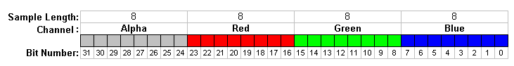
Sample Length:
8 |  |  |  |  |  |  |  | 8 |  |  |  |  |  |  |  | 8 |  |  |  |  |  |  |  | 8
Alpha |  |  |  |  |  |  |  | Red |  |  |  |  |  |  |  | Green |  |  |  |  |  |  |  | Blue
31 | 30 | 29 | 28 | 27 | 26 | 25 | 24 | 23 | 22 | 21 | 20 | 19 | 18 | 17 | 16 | 15 | 14 | 13 | 12 | 11 | 10 | 9 | 8 | 7 | 6 | 5 | 4 | 3 | 2 | 1 | 0
Channel:
Color:
Bit Number:

Slide 3
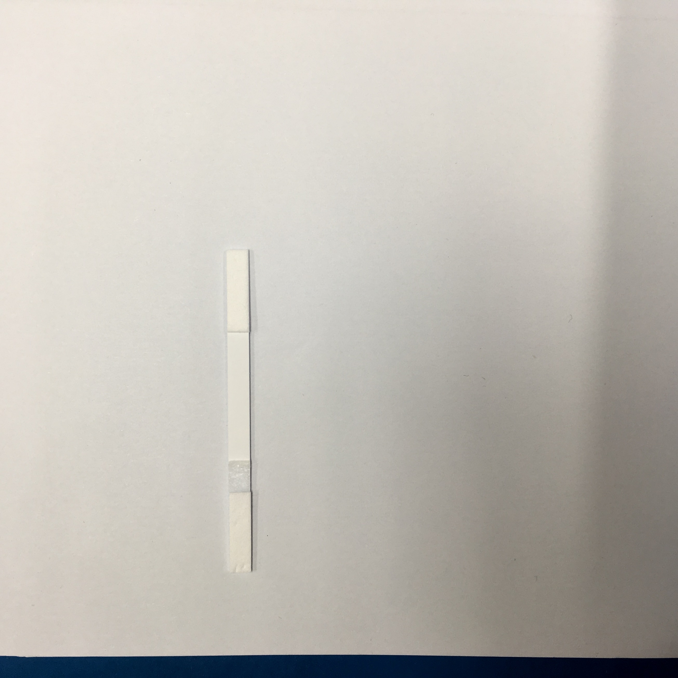
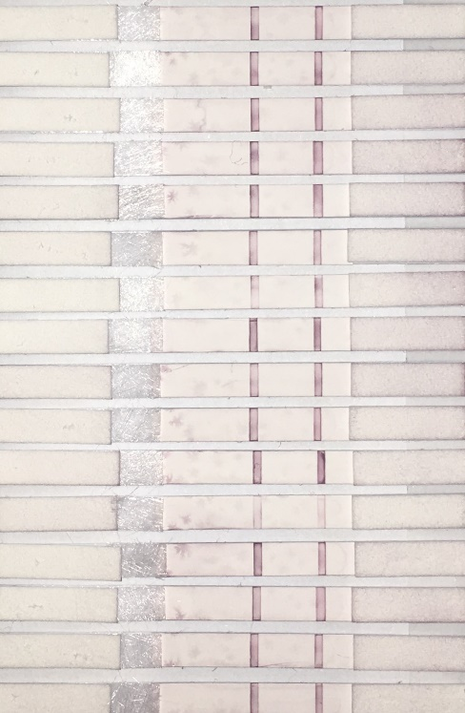
Absorbent Pad
Control line
Control line
Test line
Test line
Membrane
Flow
Region of Interest
Conjugate Pad
Sample Pad

Slide 4
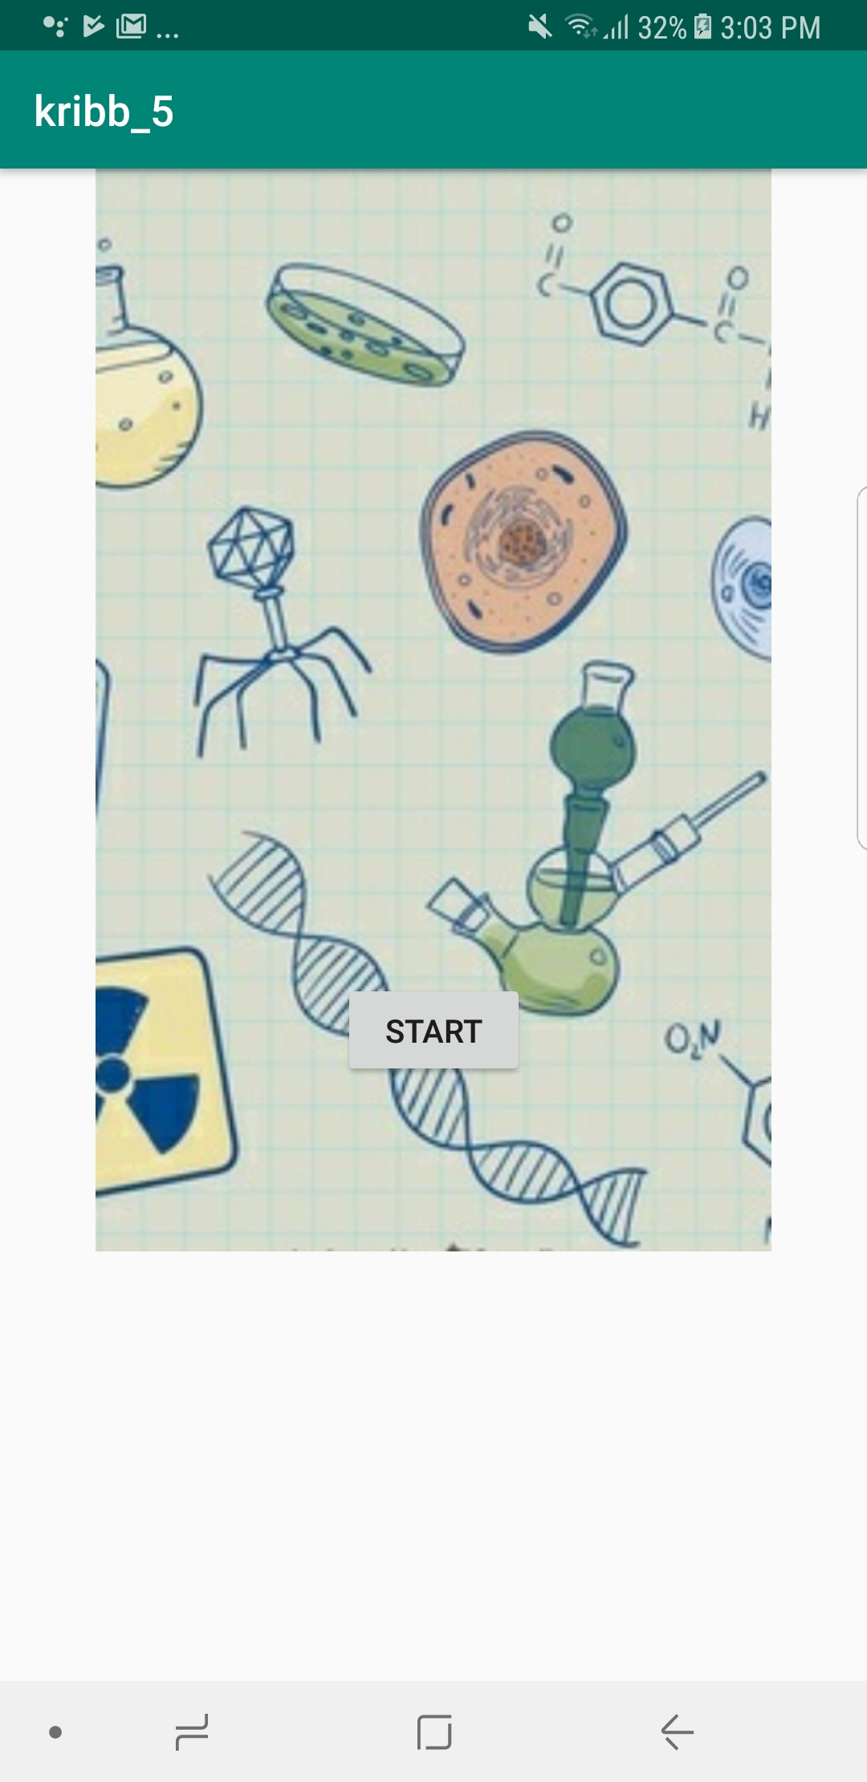

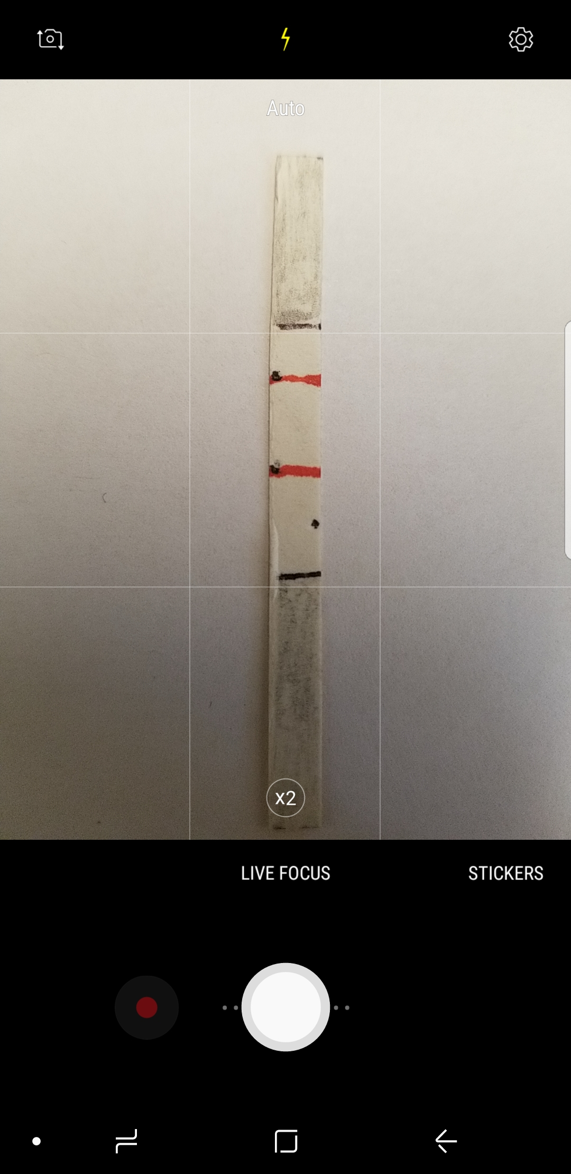
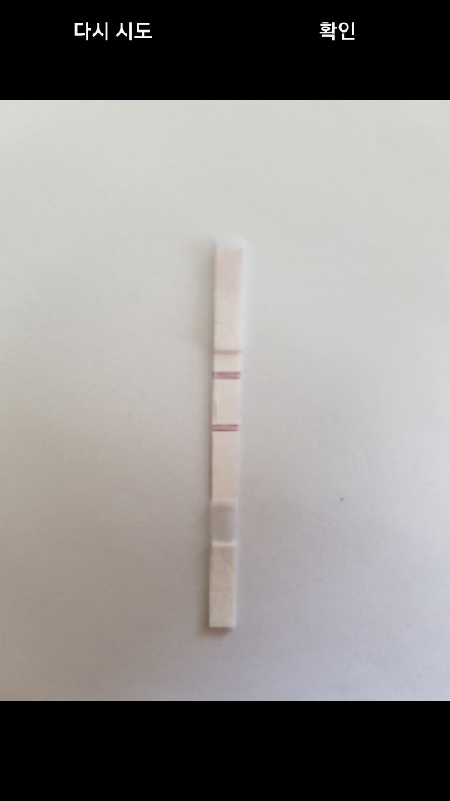

Slide 5
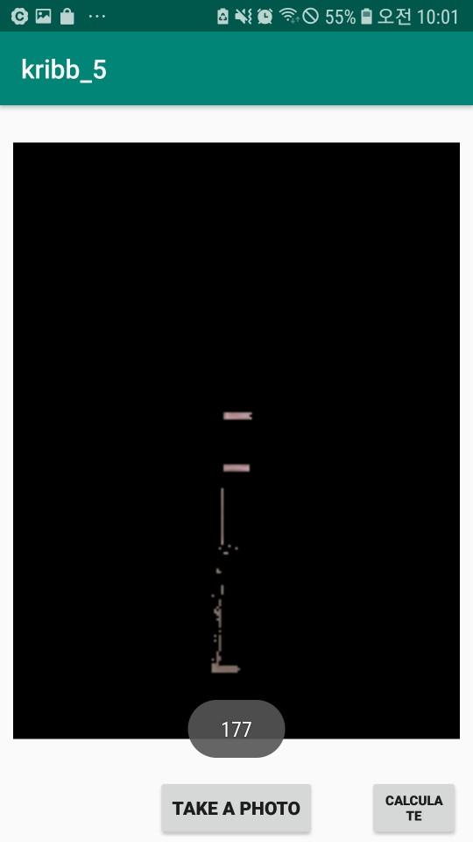
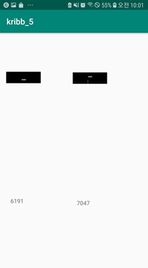
(d)
(e)
(f)

Slide 6
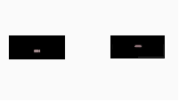
Control Line
Test Line

Slide 7
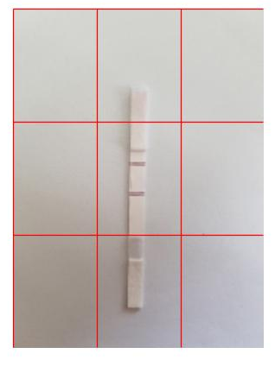
(a)

Slide 8
Start Application
Open Camera
Strip Placement
Capture Image
Show Test and Control Line Pixel Values
Calculate
Total Pixel Number
Automatic Binarization and Masking
Starting application
Turning on camera
Placing strip and capturing image
Displaying cumulative intensity of test and control line
Calculating pixel number
Binarizing and masking

Slide 9
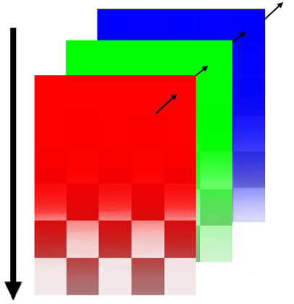
Pixel A [255, 255, 255, 255]
Opacity (high to low)
Blue component image plane
Green component image plane
Red component image plane

Slide 10
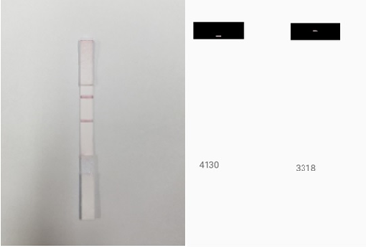
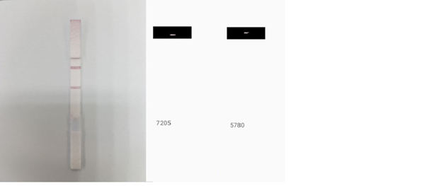
T/C ratio = 0.8034
T/C ratio = 0.8022

Slide 11
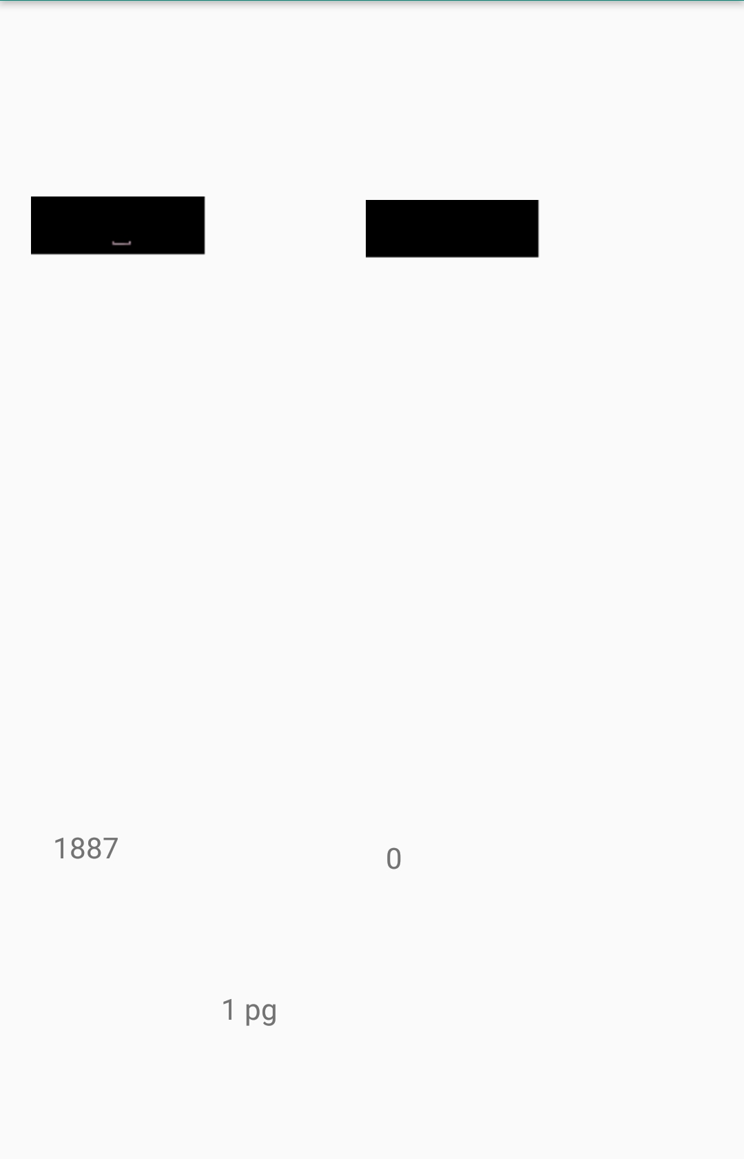
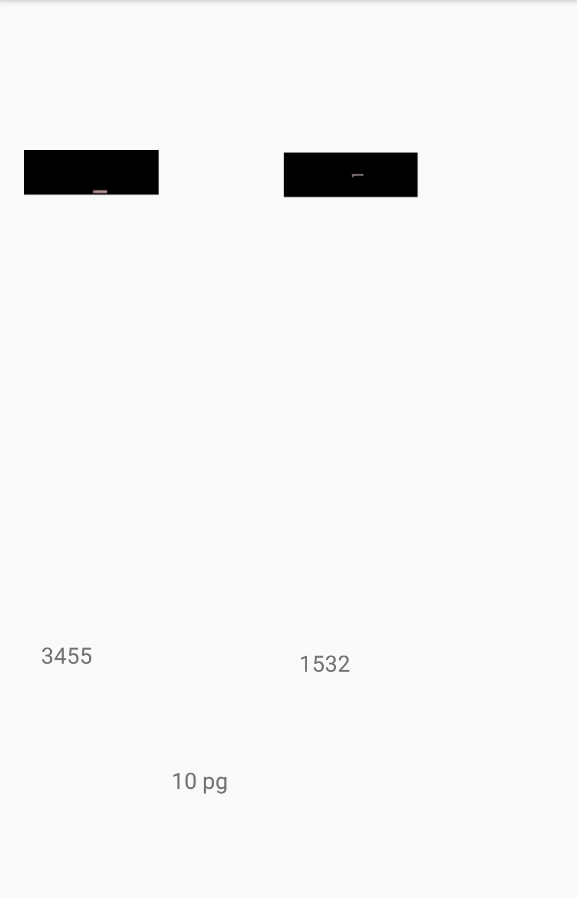
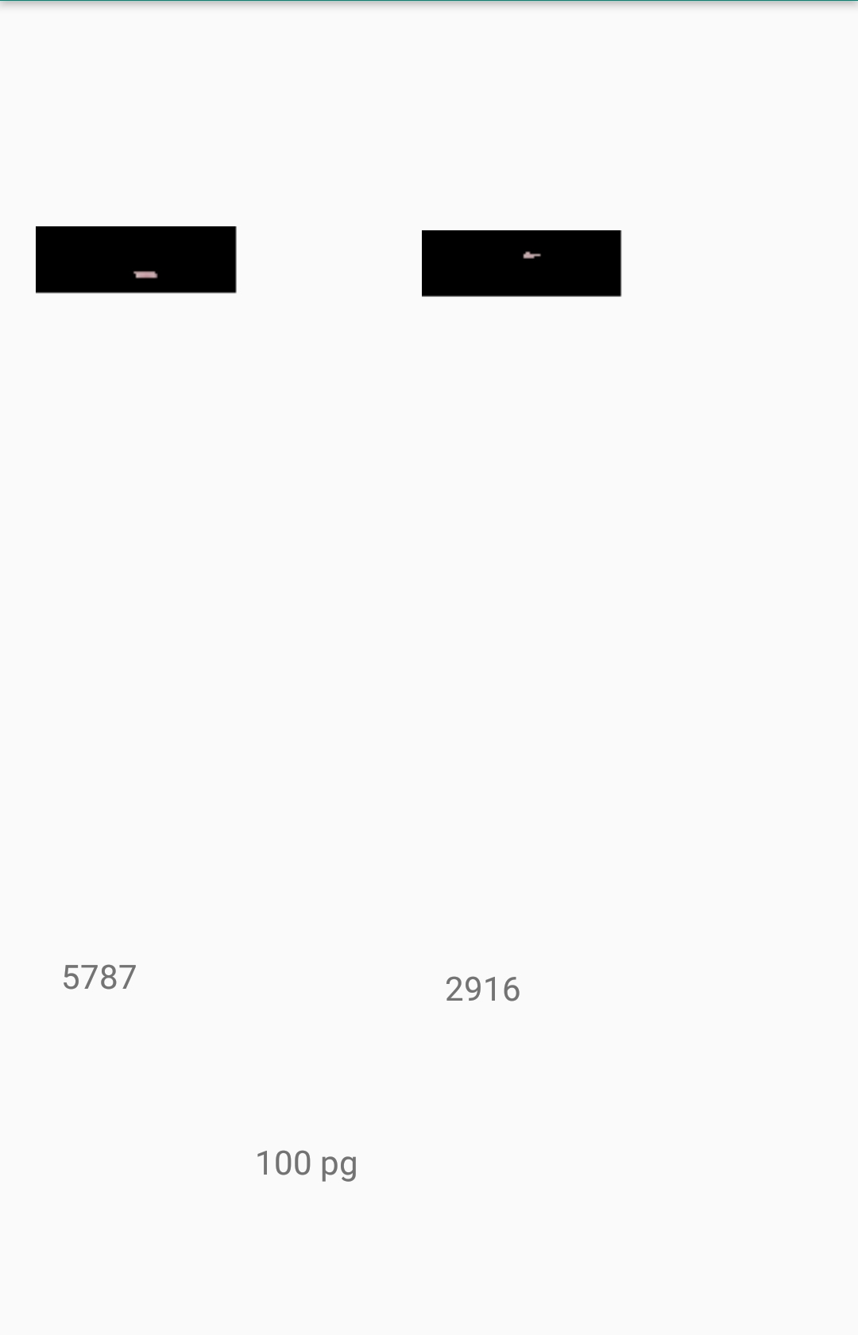


10 fg
100 fg
1 pg
10 pg
100 pg

Slide 12
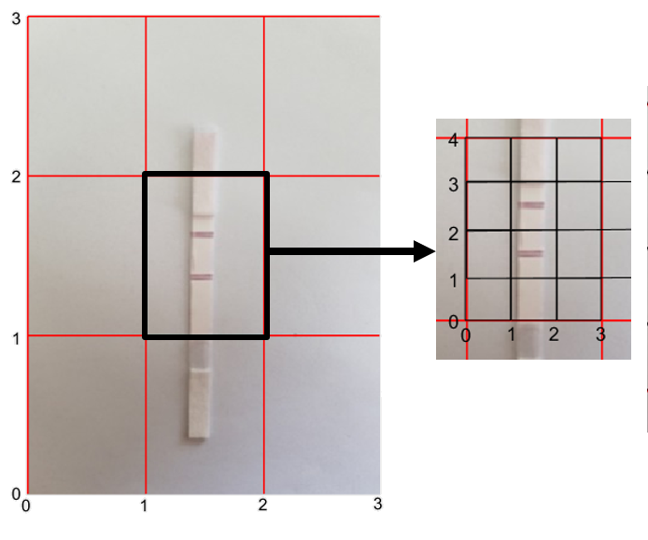
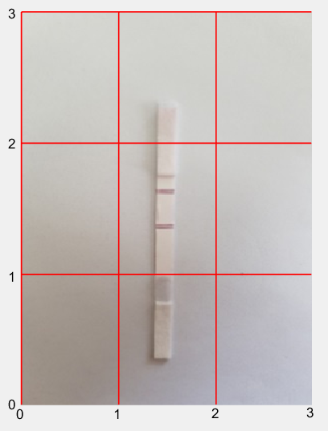
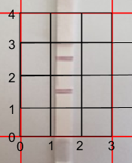

Slide 13
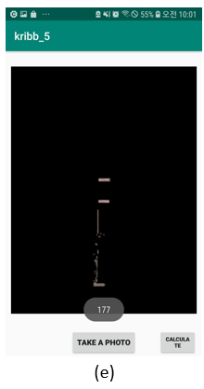
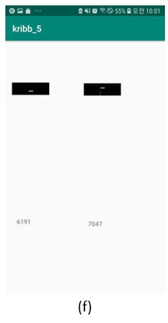

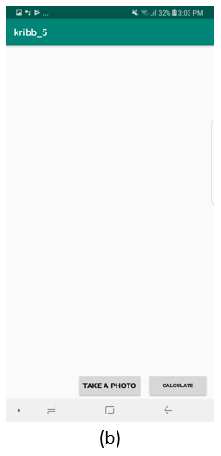
LFA KRIBB

